Slide 1
Counters VS Accumulators
Chapter 7 – Part 2

Slide 2
Potential Error condition
Names to call it
example
Cout << “enter hours worked: “;
Cin >> hourswrkd;
While (hourswrked > 0)
{
Hourpay = hourswrked * 35.00;
Cout << “ your hourly rate is: “ << hourpay;
} //endwhile
Endless loop
Infinite loop

Slide 3
Potential Error condition Explained
Why?
example
Cout << “enter hours worked: “;
Cin >> hourswrkd;
While (hourswrked > 0)
{
Hourpay = hourswrked * 35.00;
Cout << “ your hourly rate is: “ << hourpay;
} //endwhile
In the code on the right side, the hourswrked never gets updated. The loop will not end.

Slide 4
1. Write a c++ while clause to:
Process the loop body as long as the value in quantity is greater than 0

Slide 5
1. Answer
while (quantity > 0)

Slide 6
2. Write a c++ while clause to:
Stop the loop when the value in quantity is less than 0

Slide 7
2. Answer:
while (quantity < 0)

Slide 8
Question: Which of the following is a good sentinel value for a program that inputs a test score?
-9
32
45.5
7

Slide 9
Answer: Which of the following is a good sentinel value for a program that inputs a test score?
-9
32
45.5
7

Slide 10
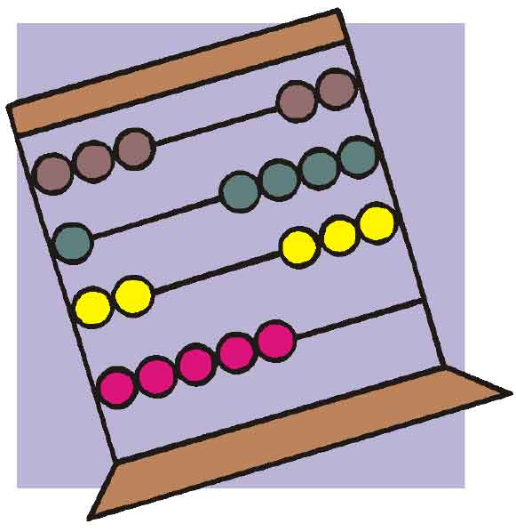

Counters and accumulators

Slide 11
Counters
Are for counting

Slide 12
accumulators
Are for accumulating amounts!

Slide 13
Counters and accumulators Need:
Initializing
Usually to 0
But always go by the algorithm
Only done once
Updating
Also called incrementing
Adding a number to the counter or accumulator
Counters are always updated by a constant number
Accumulators can be updated by varying amounts
The updating is done in the body loopy

Slide 14
Now we can have a counter-controlled loop!
These do not use a sentinel value.
What is a sentinel value?

Slide 15
What is a sentinel value?
A value that ends a loop once it is entered.

Slide 16
Example
Int numcnt = 0;
While (numcnt < 10)
{
Cout >> “The number count is: “ >> numcnt >> endl;
Numcnt = numcnt +1;
} //endwhile

Slide 17

Your Turn!

